Slide 1
Campbell Ch 42 Respiratory/Circulatory systems
Derek Liu

Slide 2
Circulatory system

Slide 3
Overview
Every organism must exchange materials with its environment
Exchanges ultimately occur at the cellular level by crossing the plasma membrane
In unicellular organisms, these exchanges occur directly with the environment

Slide 4
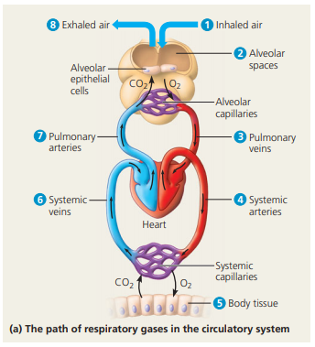
General Properties of the Circulatory System
A circulatory system has:
A circulatory fluid
A set of interconnecting vessels
A muscular pump, the heart
What are the 2 types of circulatory systems?

Slide 5
Open vs Closed Circulatory System
Open circulatory system: in insects, other arthropods, and most molluscs
Blood bathes the organs
No distinction between blood and interstitial fluid →
hemolymph

Slide 6
Open vs Closed Circulatory System Cont.
Closed circulatory system: blood is confined to vessels and is distinct from the interstitial fluid
More efficient at transporting circulatory fluids to tissues and cells
Annelids, cephalopods, and vertebrates have closed circulatory systems

Slide 7
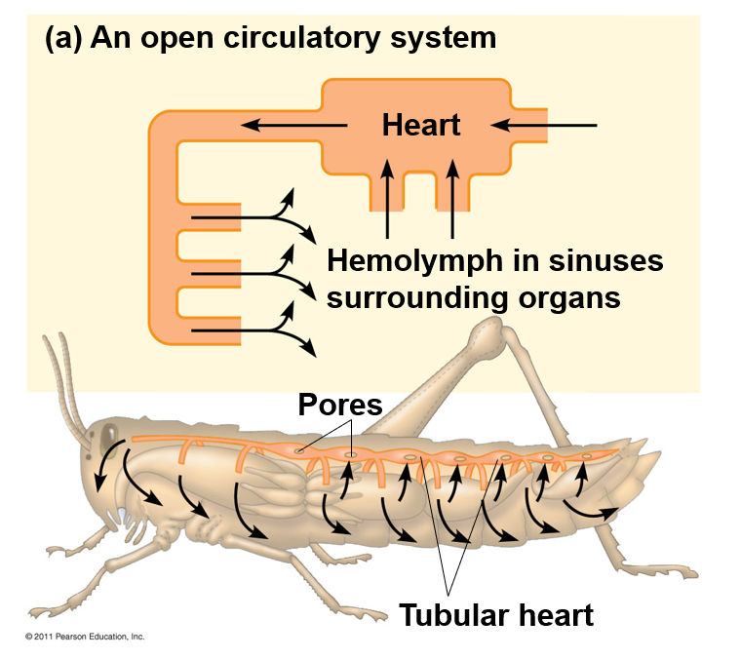

Slide 8
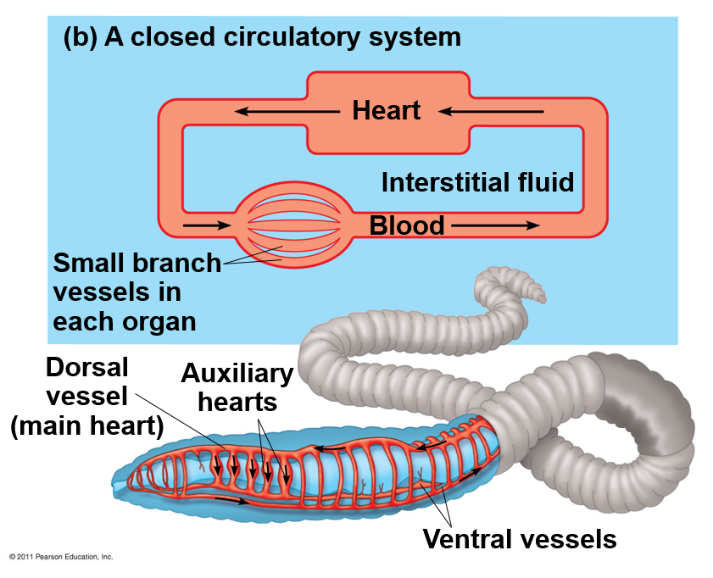

Slide 9
The tubes
Arteries, veins, and capillaries
Blood flow is one way
Arteries → arterioles → capillaries
Away from heart
Capillaries → Venules → Veins
Towards the heart

Slide 10
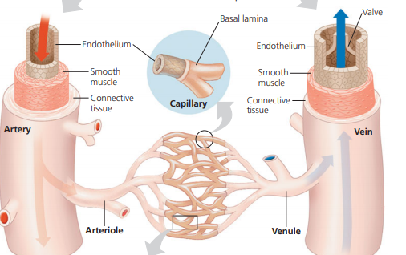

Slide 11
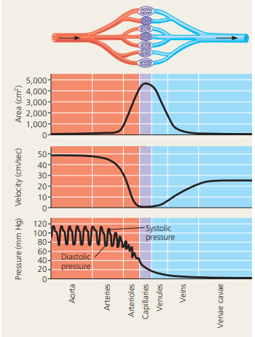

Slide 12
The cardiovascular system + the heart
Right ventricle pumps blood to the lungs
In the lungs, the blood loads O₂ and unloads CO₂
Blood from the lungs enters the heart at the left atrium
Then is pumped through the aorta to the body tissues by the left ventricle
Comes back to the right atrium through the superior vena cava/inferior vena cava
In summary: RV→ Lungs, Lungs → LA, LV → Body, Body → RA

Slide 13
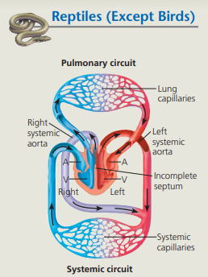
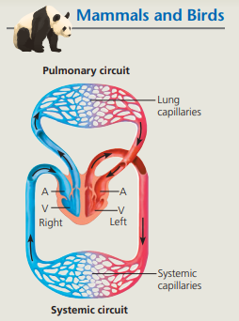
Snakes vs. Humans

Slide 14
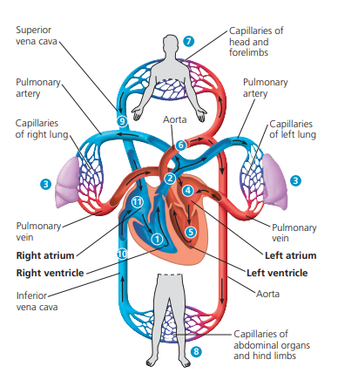
Mammalian Cardiovascular system

Slide 15
Blood Pressure
Systolic pressure: pressure in the arteries during ventricular systole
Diastolic pressure: pressure in the arteries during diastole (lower than systolic pressure)
A pulse: rhythmic bulging of artery walls with each heartbeat

Slide 16
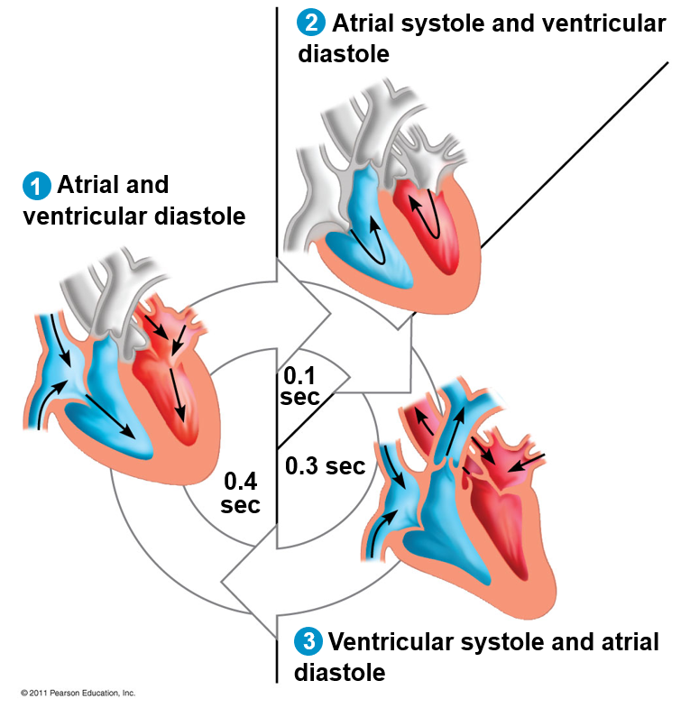

Slide 17
Valves of the heart
Valves prevent backflow of blood in the heart
The atrioventricular (AV) valves separate each atrium and ventricle
The semilunar valves control blood flow to the aorta and the pulmonary artery

Slide 18
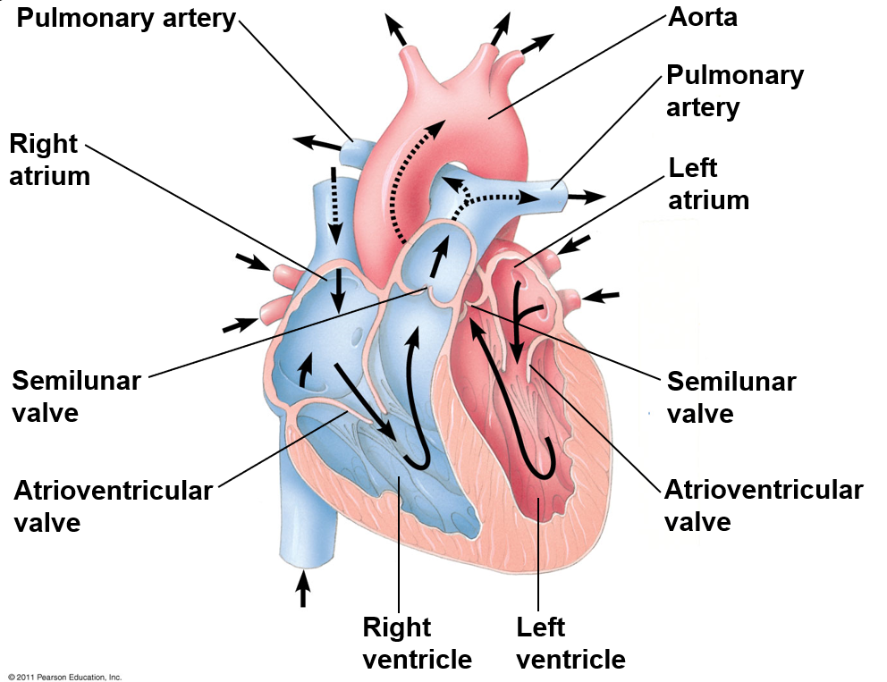

Slide 19
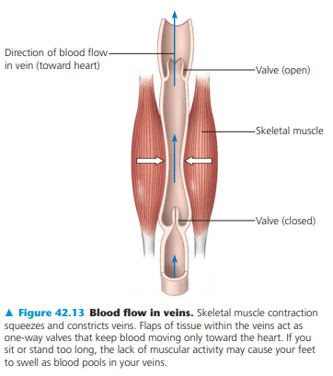

Slide 20
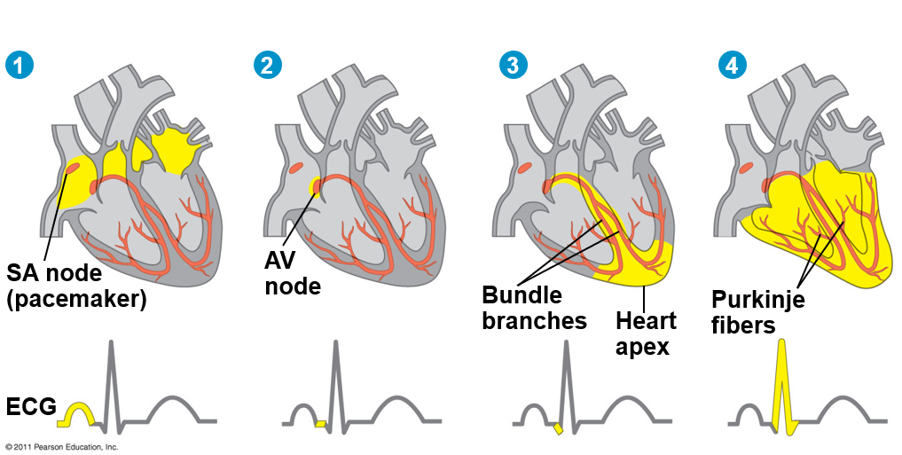
ECG diagram/signaling

Slide 21
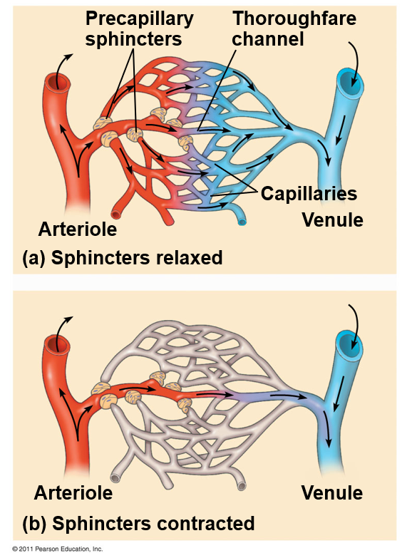

Slide 22
Respiratory System

Slide 23
Mammalian Respiration: Lungs
Lungs are an infolding of the body surface
Transports gases between the lungs and the rest of the body
Inhalation vs. exhalation

Slide 24
How does air travel?
Air is inhaled through the nostrils
Pharynx directs air to the lungs and food to the stomach
Air passes through the pharynx, larynx, trachea, bronchi, and bronchioles to the alveoli, where gas exchange occurs

Slide 25
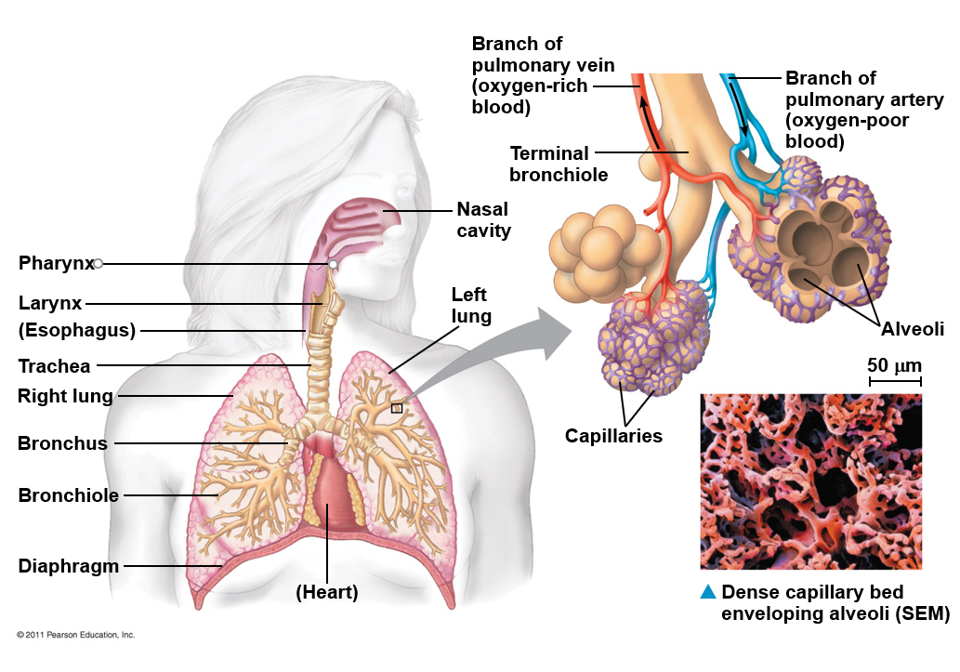

Slide 26
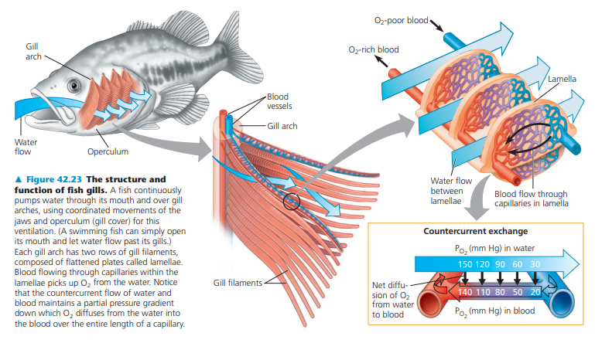
Fish Breathing

Slide 27
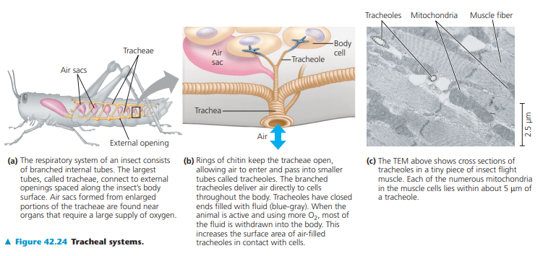
Insect Breathing

Slide 28
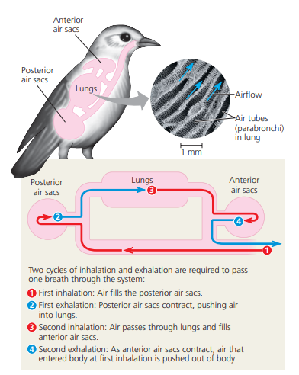
Bird Breathing

Slide 29
Breathing in frogs vs. humans
Mammals do negative pressure breathing
Pulling, not pushing, air into lungs
Frogs do positive pressure breathing
Inflates lungs with forced airflow

Slide 30
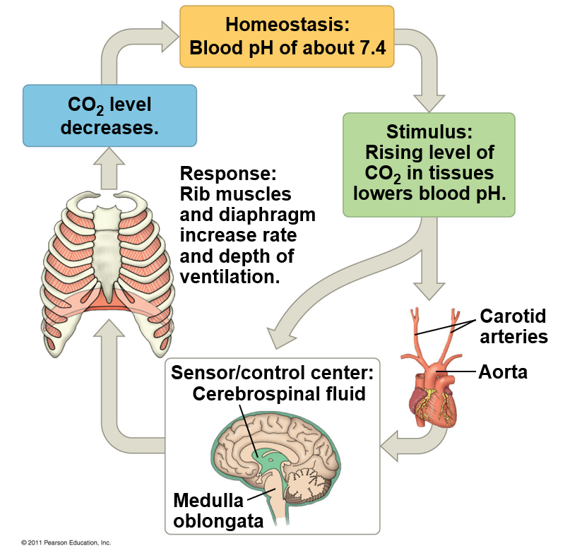
Regulating Respiration

Slide 31

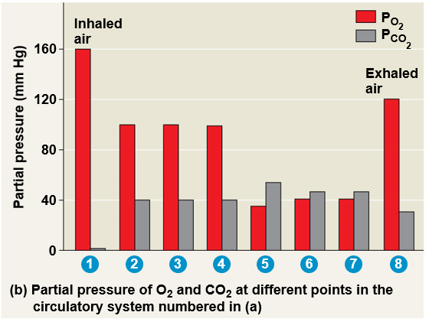

Slide 32
